Slide 1

Unit 8: THE WEATHER
Lesson 3.1
Page 112

Slide 2
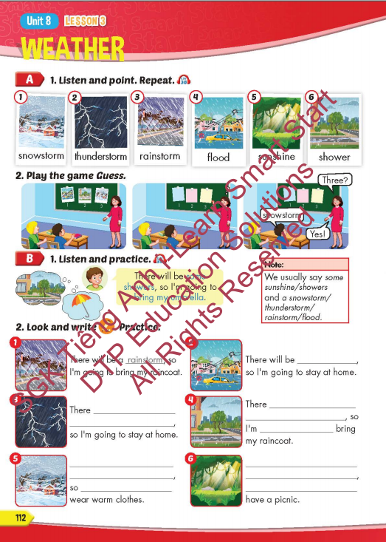
Lesson Outline
Warm-up
Vocabulary
Structure
Consolidation
Wrap-up

Slide 3
Objectives
By the end of this lesson, students will be able to to talk about future weather and the things they're going to do.
Vocabulary: snowstorm, thunderstorm, rainstorm, flood, sunshine, shower.
Structure: There will be some showers, so I'm
going to bring my umbrella.

Slide 4

Structure
There will be some showers, so I’m going to bring my umbrella.

Slide 5

Presentation

Slide 6
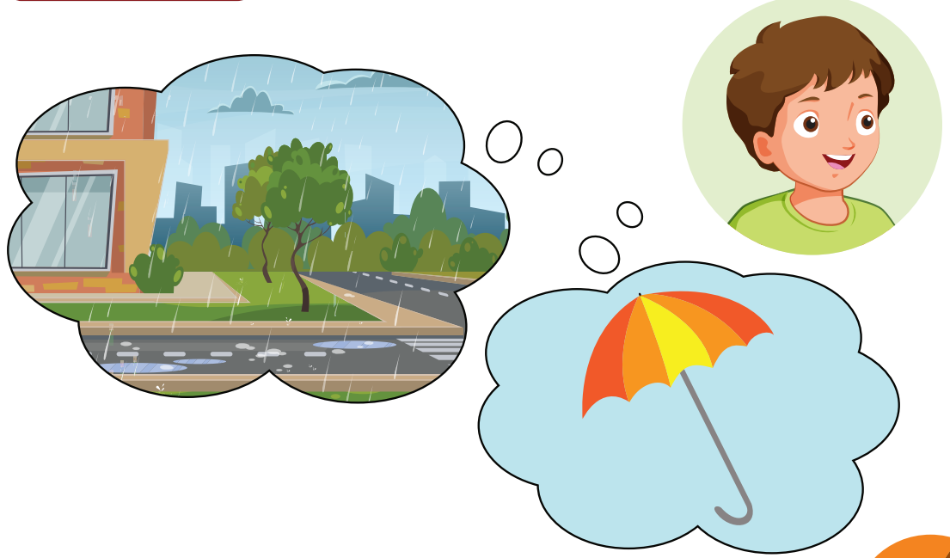
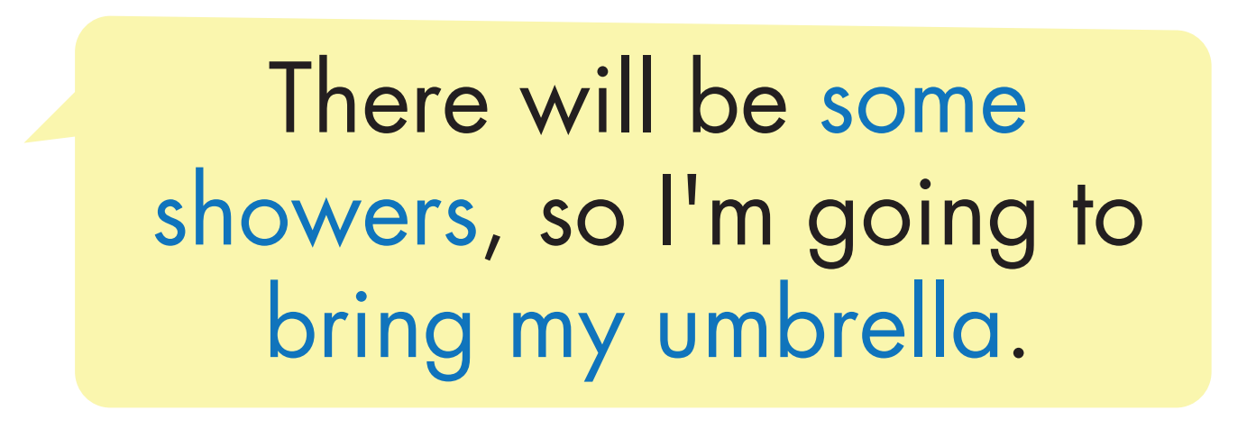
Structure

Slide 7
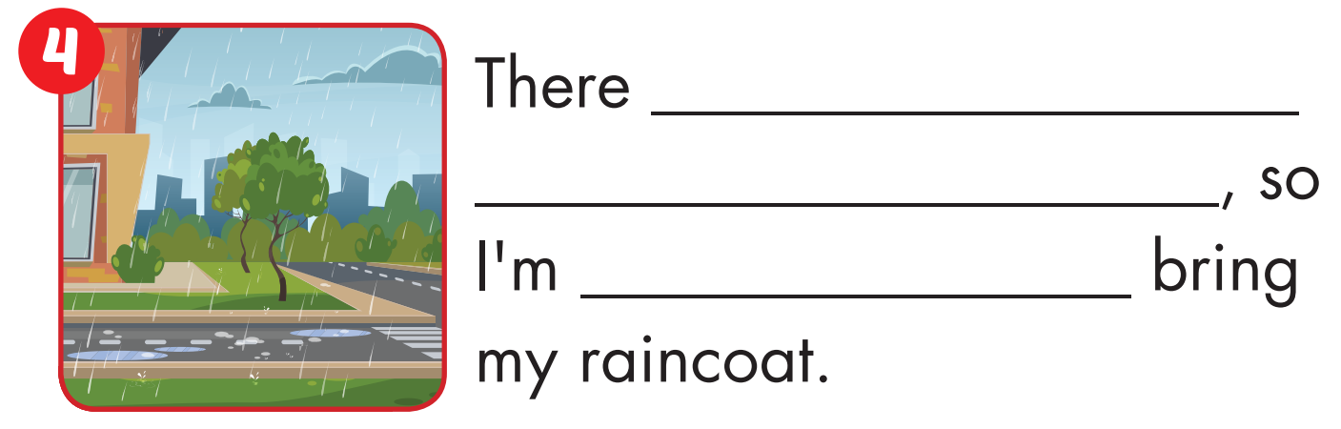
will be some showers
going to

Slide 8
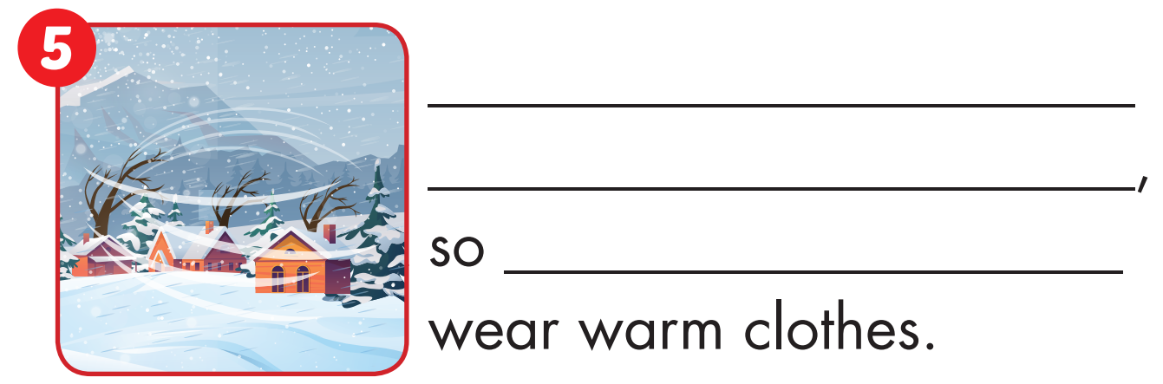
There will be a snowstorm
I’m going to

Slide 9
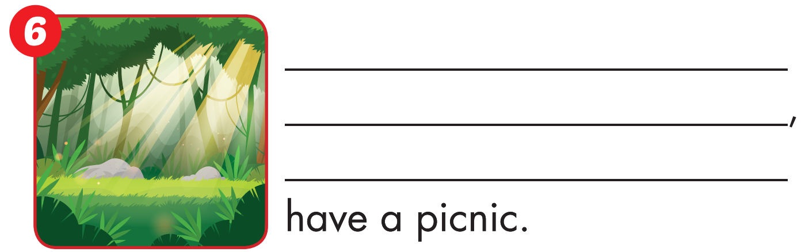
There will be some sunshine
I’m going to

